Slide 1
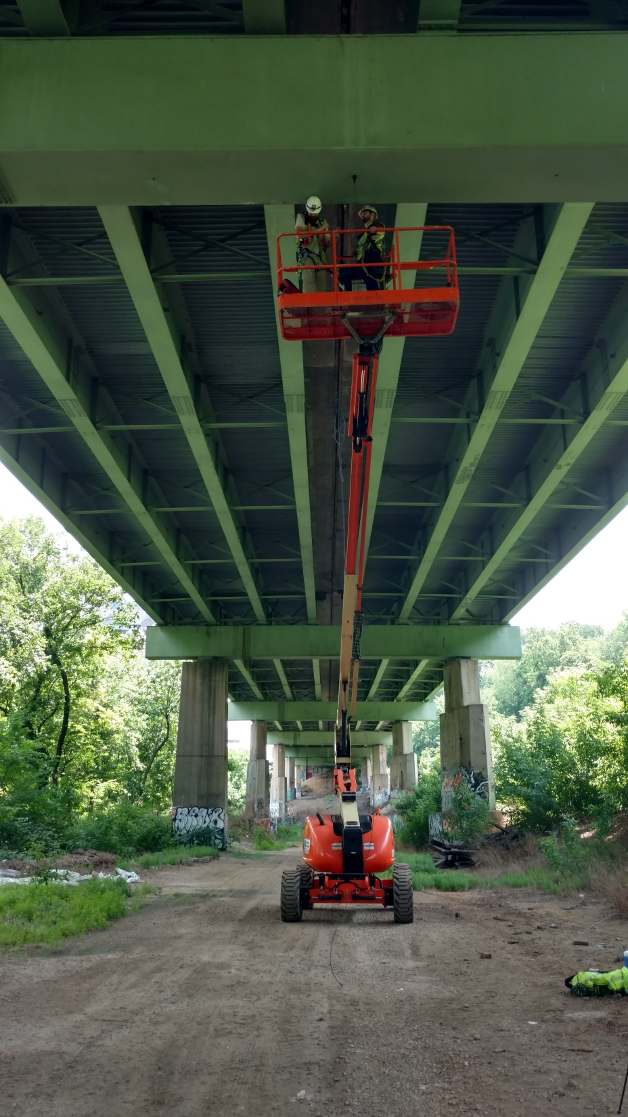
I76 Viaduct Vibration Survey
Test Debrief
Drexel University
Rutgers University
PennDOT District 6

Slide 2
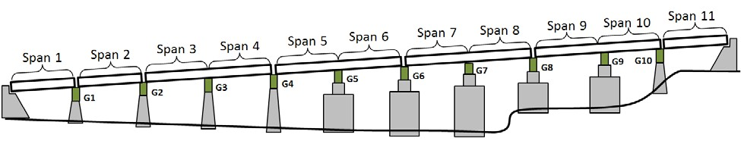
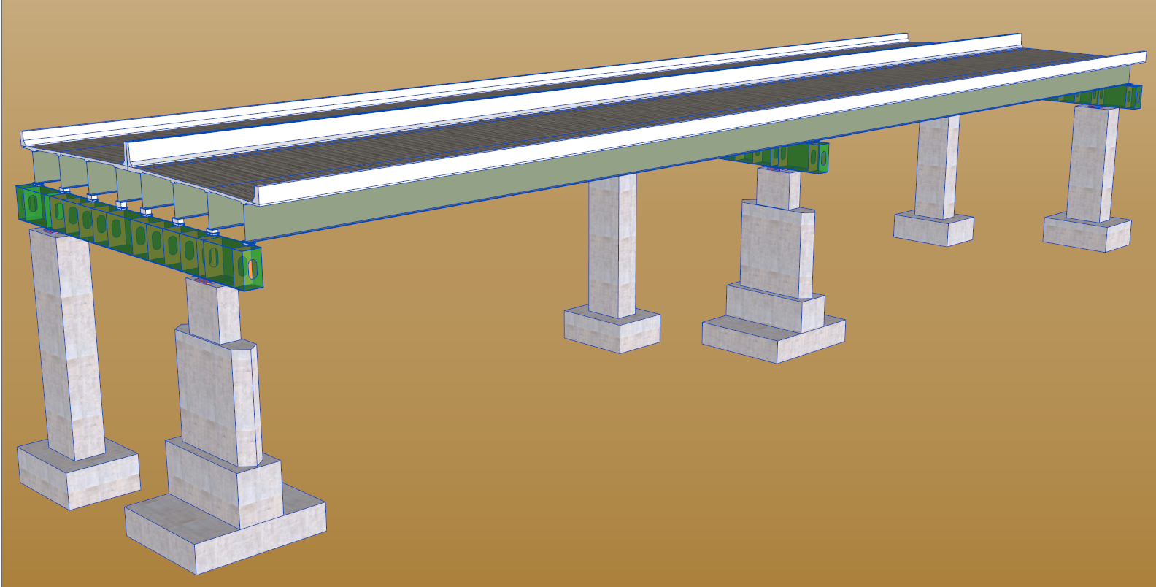
Chosen Section
Span 8
G8
G7
Span 7
G6
30 Accelerometers
12 Strain Gauges
Collected >12 hours of data

Slide 3
Instrumentation Plan
30 Accelerometers:
22 vertically oriented accels
3 transversely oriented accels
5 longitudinally oriented accels
12 Strain Gauges
9 on W-Beams. 3 on Box Girder
3’
X-Section
h/3
h/3
h/3
Accel.
Strain
6”
Span 7
Span 8
2’
1/4
Midspan
3/4
1/4

Slide 4
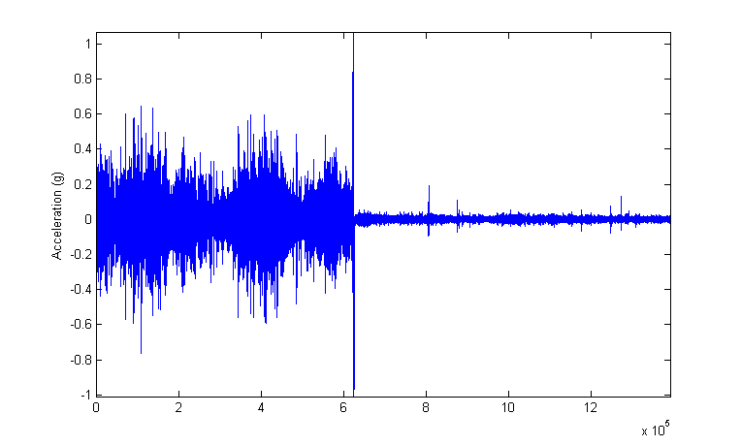
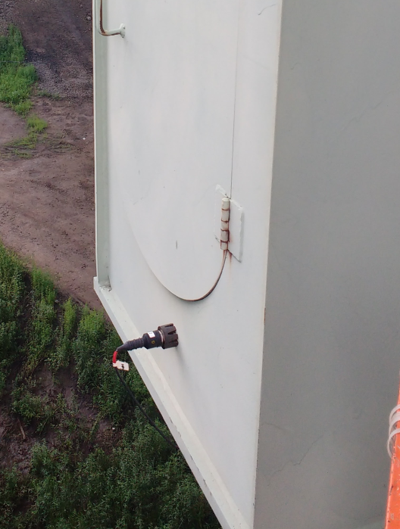
3’
RMS = 0.0756
RMS = 0.0062

Slide 5
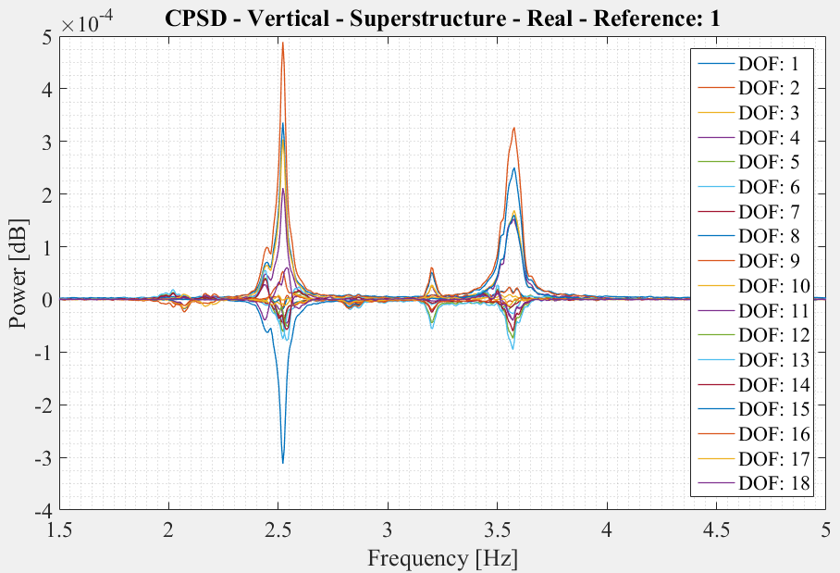

Slide 6
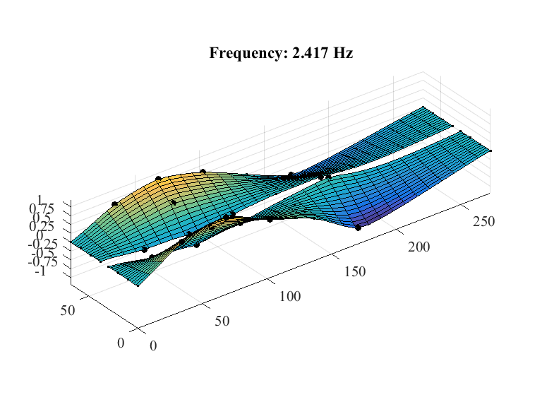
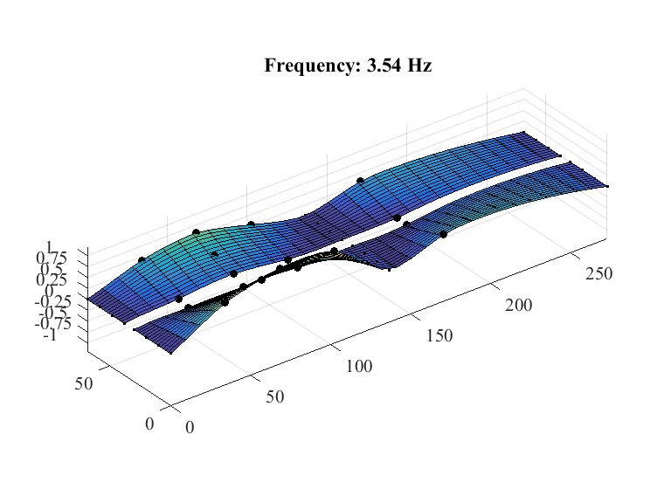

Slide 8
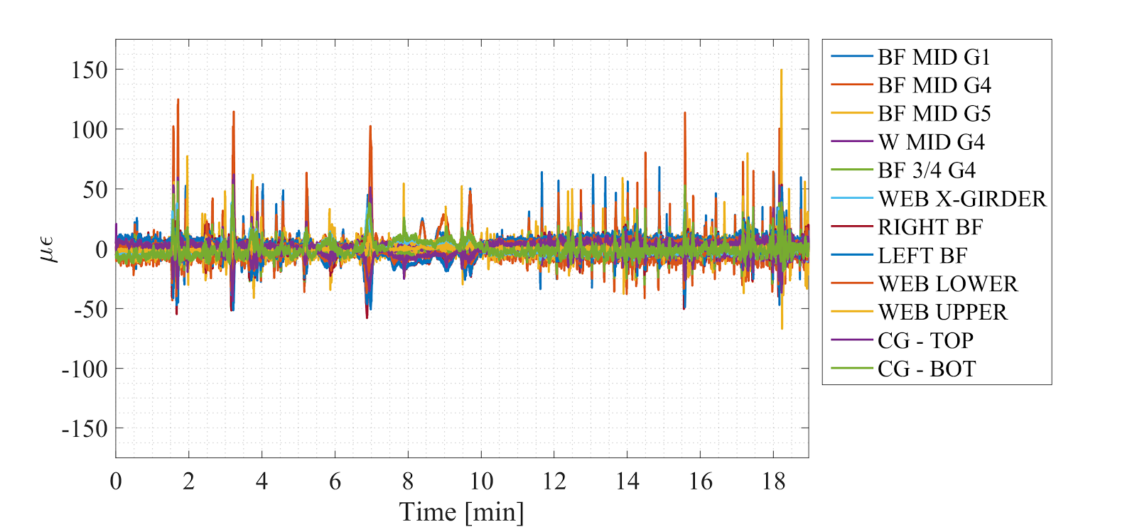
Strain Time History - 07272016 - 3:35PM to 3:53PM

Slide 9

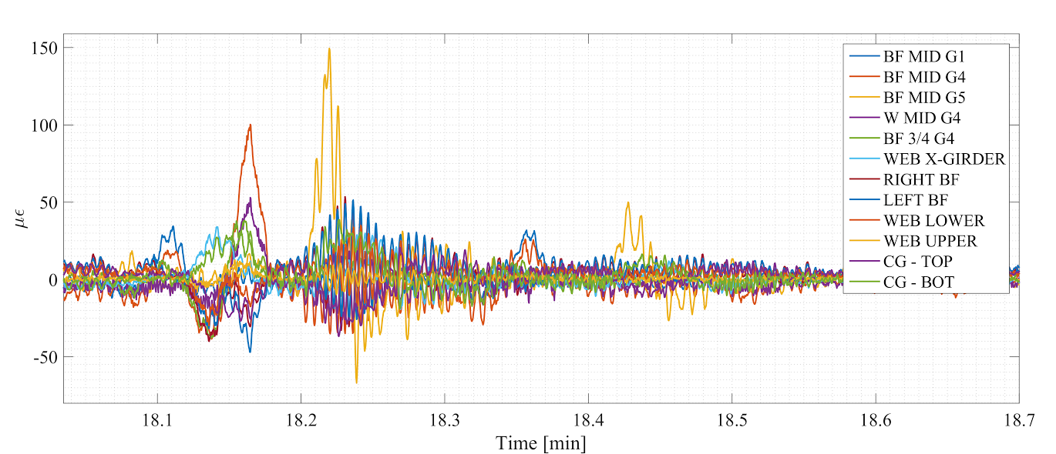
Strain Time History - Largest Event

Slide 10
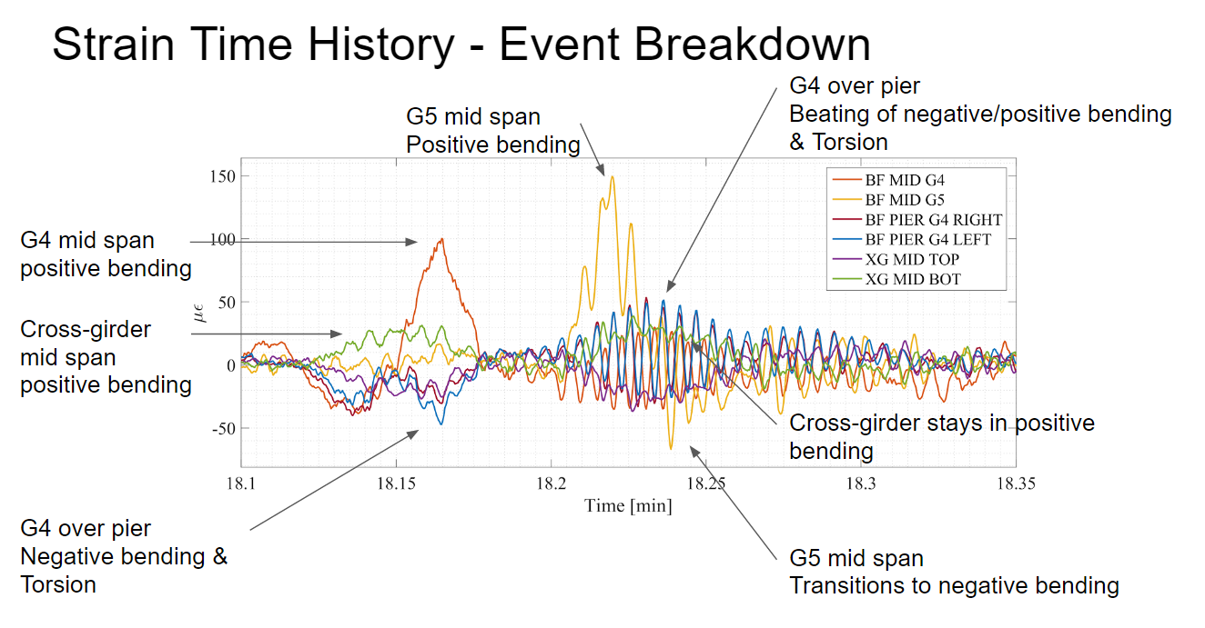

Slide 11
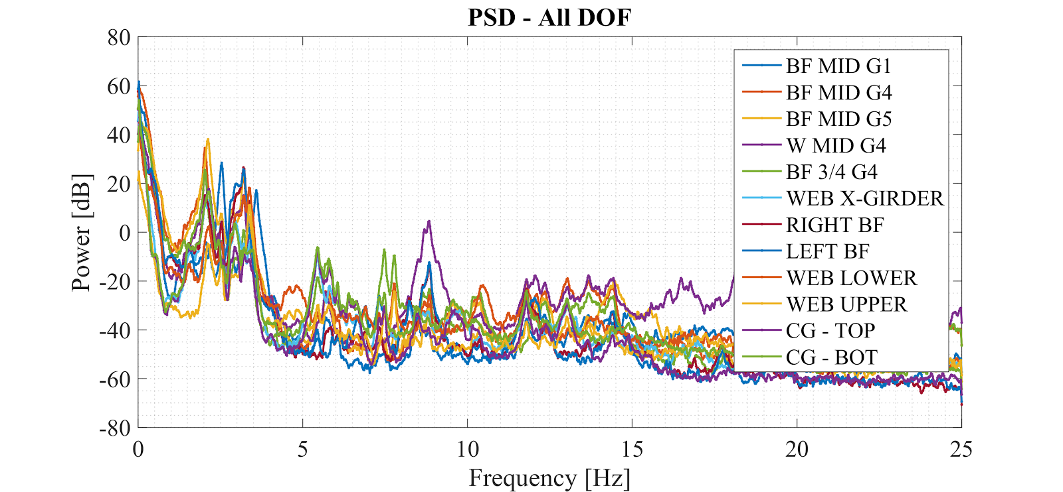
PSD: 0-25 Hz

Slide 12
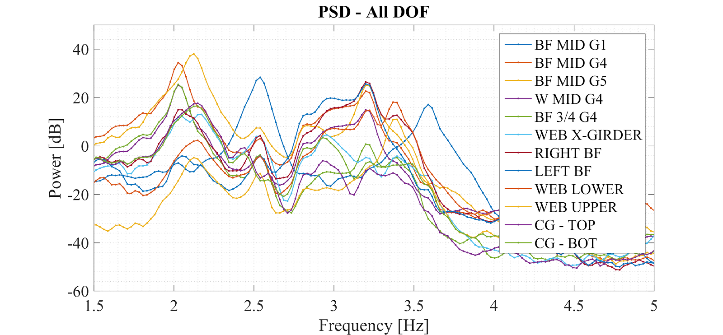
PSD - Zoom

Slide 13
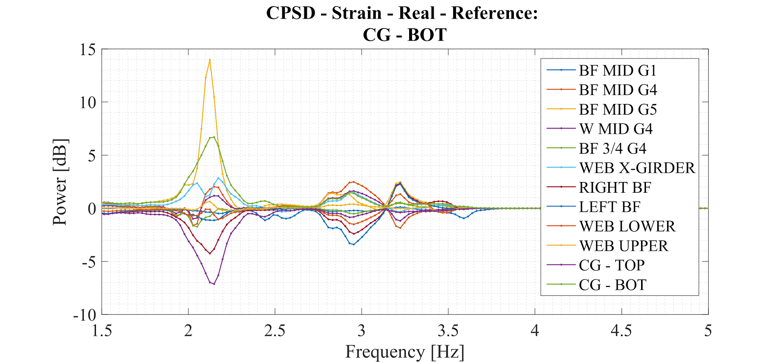
CPSD

Slide 14
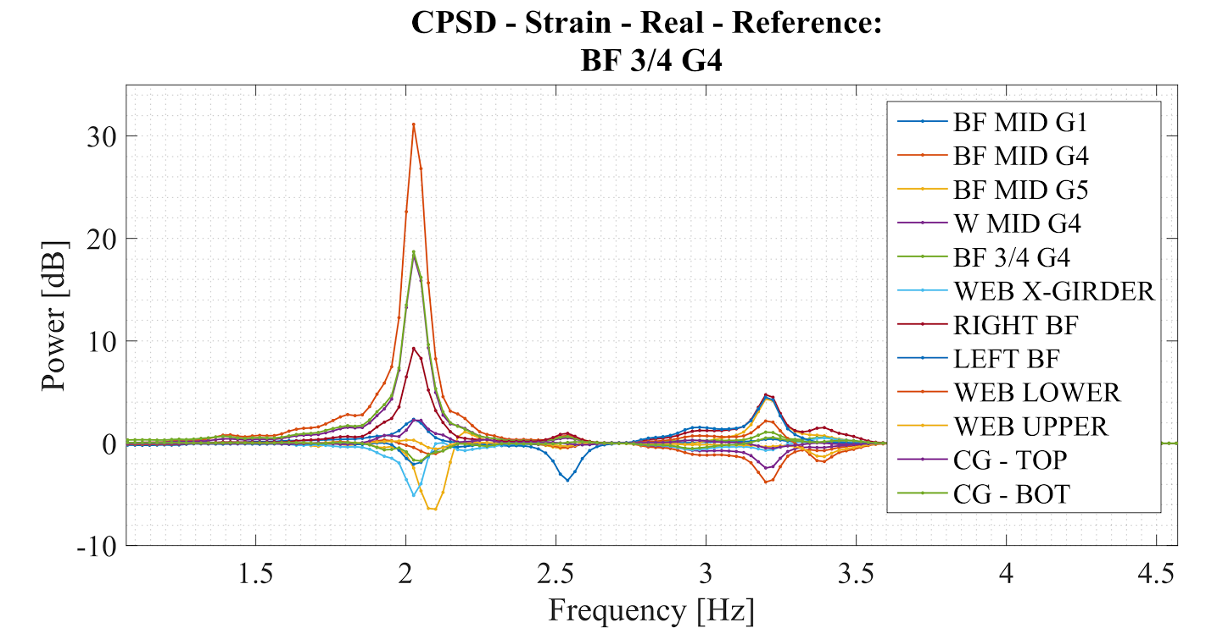
CPSD

